Slide 1

SPACE ALLOCATION TECHNIQUES
Design Optimization Toolset (DOTS)
Nirvik Saha, Ph.D., Post-Doctoral Fellow at Rensselaer Polytechnic Institute
Dennis Shelden, Ph.D., Director of Center for Architecture Science & Ecology, Rensselaer Polytechnic Institute
John Haymaker, AIA, Ph.D., Director of Research at Perkins and Will
Notes:
Hello I am Nirvik and I would like to present my work on the space allocation problem. I am a post doctoral fellow at Center for Architecture Science and ecology at RPI.
Dr. Dennis Shelden is the director of the lab and was my PhD guide at Georgia Tech.
Dr. John Haymaker, is the director of Research at Perkins and Will, who introduced the problem of Space planning which led to this investigation.

Slide 2
Space Allocation Techniques (SAT)
Framework
Integrate
Connected Methods
General class of constrained-problems
NP complete problem
5!=120, 10! = 3.6M+; 14!=87B+; 15!=1.3076744e+12
Floor
Site
City-Blocks
Employed in numerous design processes, across scales
Notes:
Space Allocation Problems (SAP) are general problems of partitioning
2- or 3- dimensional space and allocating program requirements to these sub-spaces.
SAPs appear in many architectural and urban design problems at several scales.
It is a NP complete and despite significant attention by computational design, a general solution to SAP remains elusive due to spatial and combinatorial complexity.
This thesis presents a comprehensive theoretical, process and application-based approach to solving this general class of problems.
The proposed SAT provides a foundation for allied processes, not in the scope of this research, such as building simulation to truly develop an architectural layout using interactive computational methods.
The efficiency of the algorithms and the generic formalism allows the proposed solution to serve as a design assistant in an iterative design process (Figure 3).
We demonstrate applications to industry case studies (Figure 5) at three scales of spatial output: space planning, site feasibility studies, urban design.

Slide 3
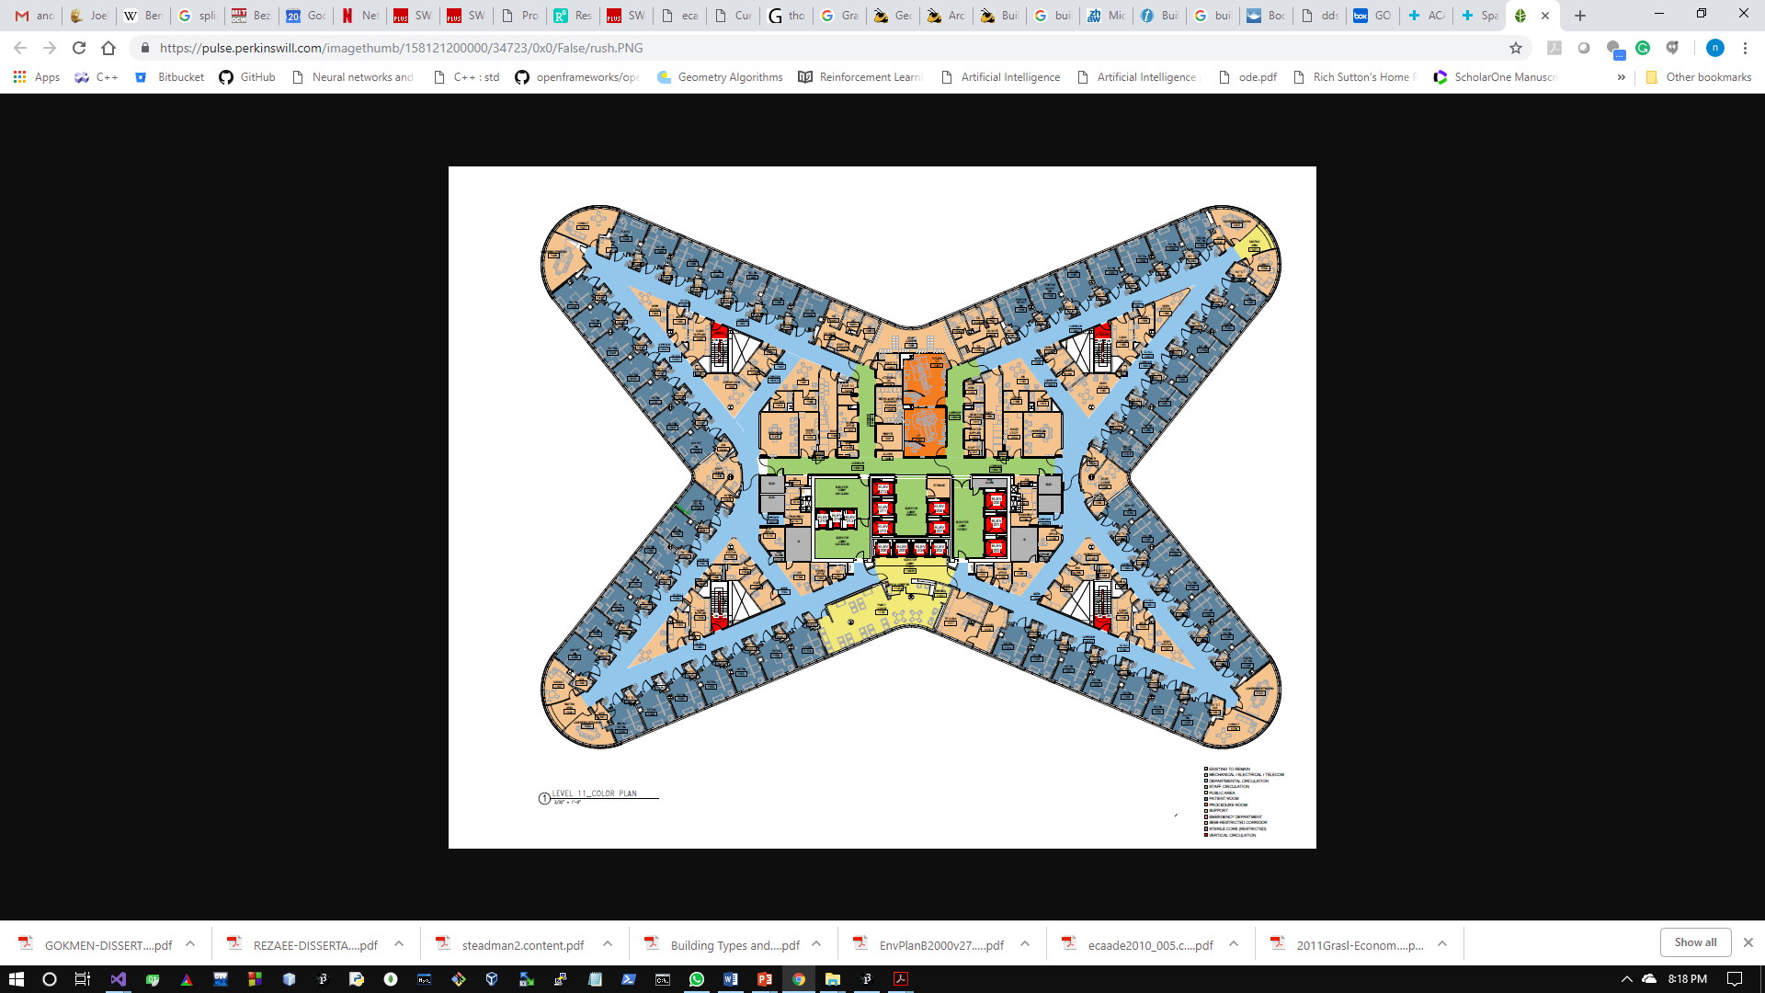
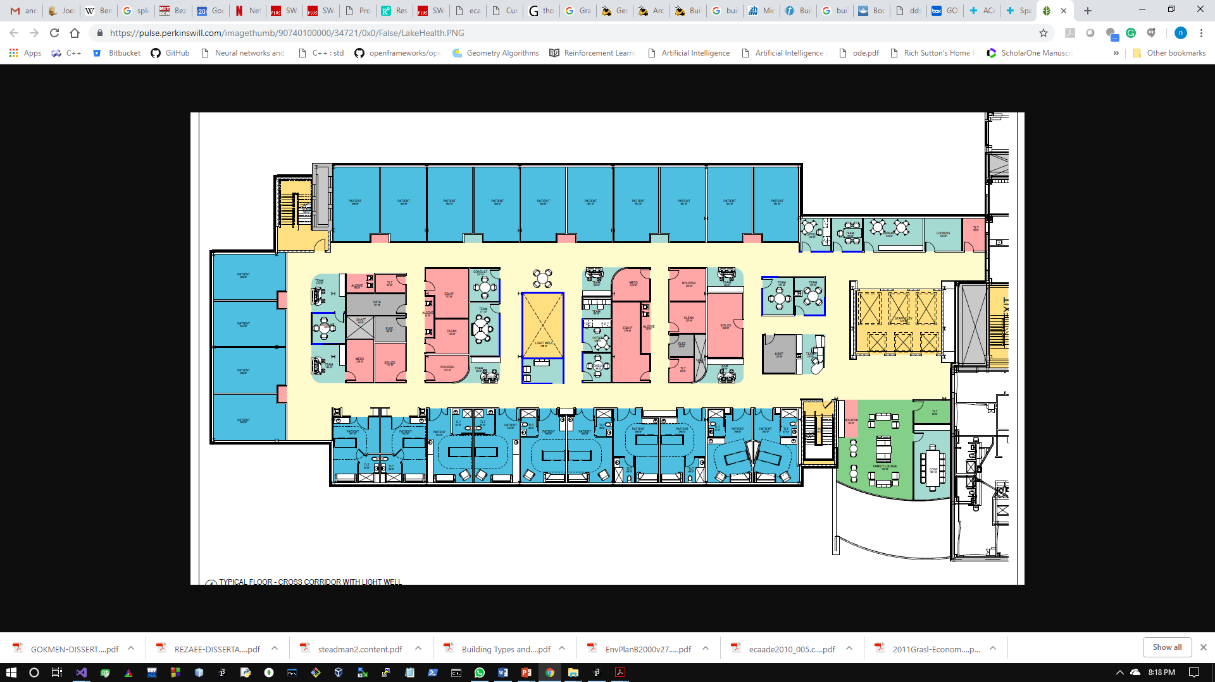
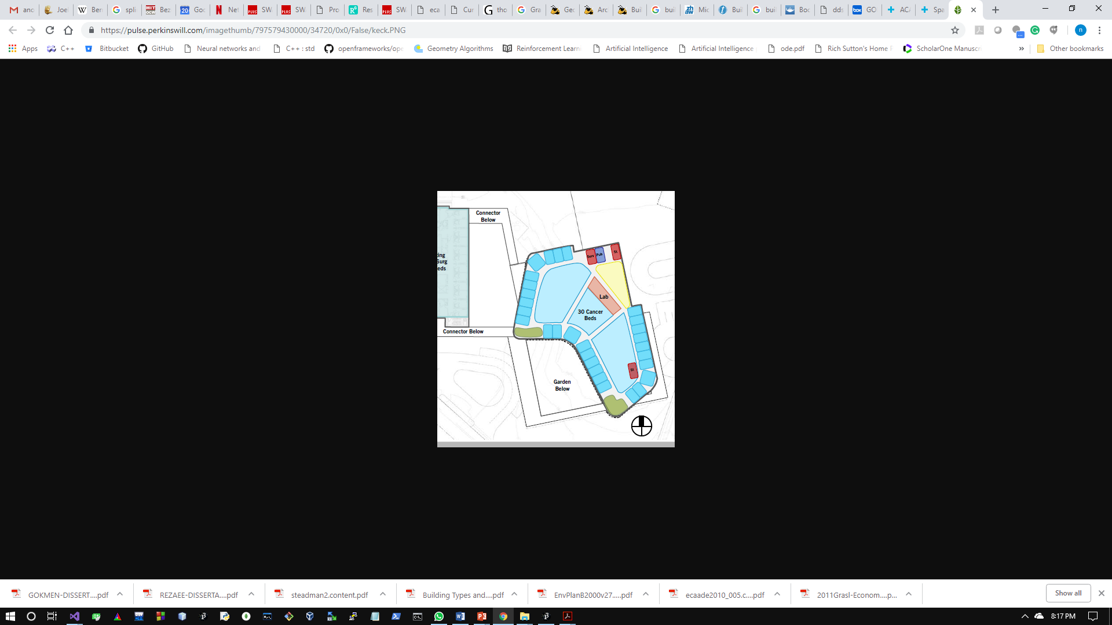
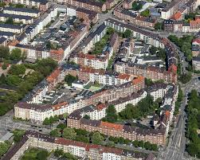
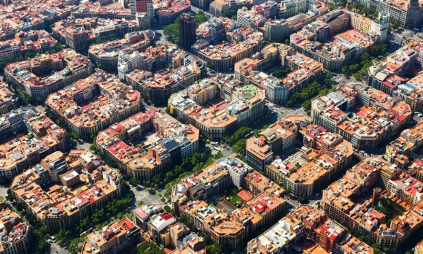
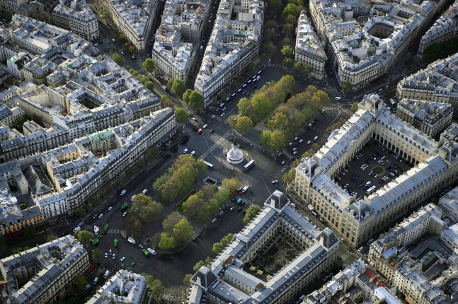
Observations
Collection of Patterns, Generalize – form / task
Geometric forms
Optimization techniques
Algebraic forms + Reinforcement Learning
Generalize geometric formulation
Simulate Data
practically impossible to collect data before design
Patterns in organization of spaces: i) along the periphery ii) subdivision of internal region.
Building floor plans
Satellite images of Barcelona, Paris, and Berlin
Notes:
In this paper, we describe geometric methods that generate commonly used shapes in design including rectangles, curves, general polygons, open curve segments, and composite shapes.
We propose that, to a large extent, the geometry of architectural spaces can be generalized by formulating spaces along a curve and internal subdivision of the bounding curve.
These methods for geometric formulation are subsequently integrated with the optimization algorithms.
Optimization process refines the topological structure of a layout. It is based on orientation, adjacency, proximity, and area constraints.
The optimization algorithm operates upon the attributes of abstract representation of the spaces and
the layout is iteratively improved by evaluating the effect of an action and tracking the score.
Circulation between spaces is achieved by procedural methods to minimize travel distance and the number of circulation-segments while maximizing the overall connectivity.

Slide 4
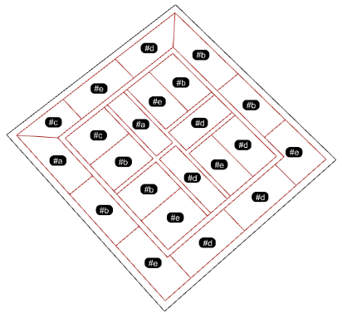
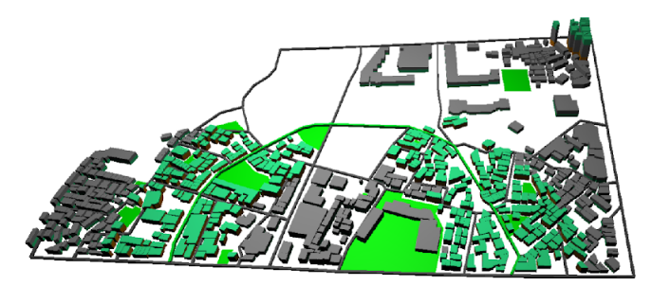
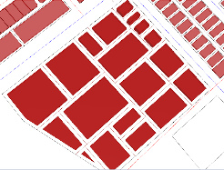
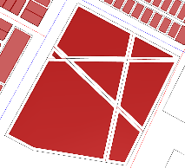
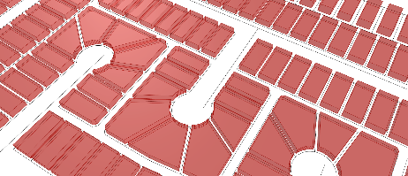
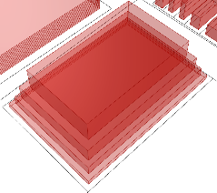
Reinforcement Learning
Environment
Agent
State
Action
Reward
Environment
Action-Value Function
Policy
Q-Learning
Methods
s
Initial State
P
Policy
a
Action
p
Probability
Reward
r
s’
New State
Floor Plans
Site Plan & massing
Space-Activity Networks of City-blocks

Slide 5
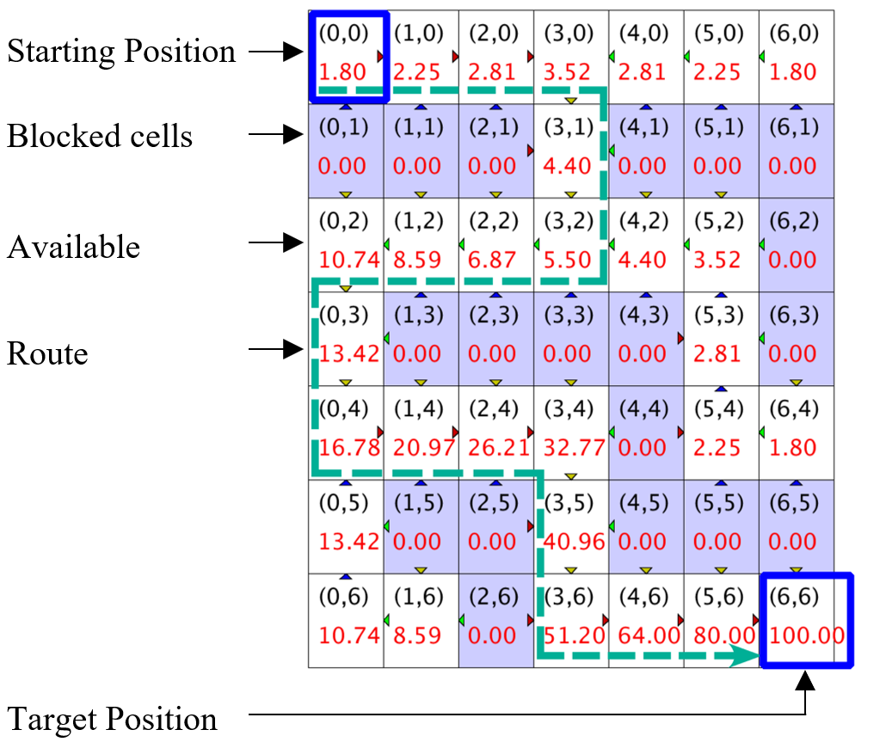
Illustration of Reinforcement Learning
Initialize Q matrix with elements set at 0
States (x,y) | 0 | 1 | …6
0 | 0.0 | 0.0 | 0.0
1 | 0.0 | 0.0 | 0.0
…6 | 0.0 | 0.0 | 100.00
Discounted rewards Reward: R(s’,a) = R(s,a)+∑_{(i=1)}^{T}γ^{(i-1)}R_{i} (where 0<γ<1, let γ=0.8)
Set of states s_{i}: {(0,0, (0,1), (0,2), …, (6,5), (6,6)}
Set of actions a_{i}: {up, down, left, right}
Updated Q matrix
States (x,y) | 0 | 1 | 2 | 3 | 4 | 5 | 6
0 | 1.80 | 2.25 | 2.81 | 3.52 | 2.81 | 2.25 | 1.80
1 | 0.00 | 0.00 | 0.00 | 4.40 | 0.00 | 0.00 | 0.00
2 | 10.74 | 8.59 | 6.89 | 5.50 | 4.40 | 3.52 | 0.00
3 | 13.42 | 0.00 | 0.00 | 0.00 | 0.00 | 2.81 | 0.00
4 | 16.78 | 20.79 | 20.21 | 32.71 | 0.00 | 2.25 | 1.80
5 | 13.42 | 0.00 | 0.00 | 40.96 | 0.00 | 0.00 | 0.00
6 | 10.74 | 8.59 | 0.00 | 51.20 | 64.00 | 80.0 | 100.00

Slide 6
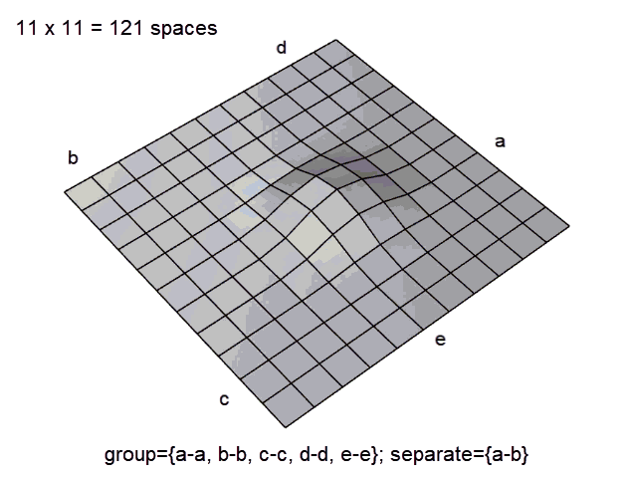
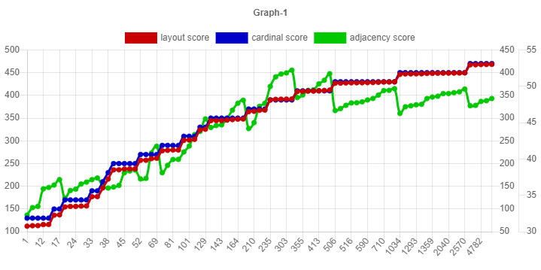
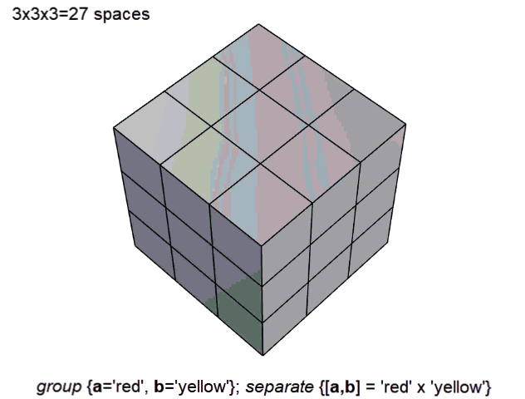
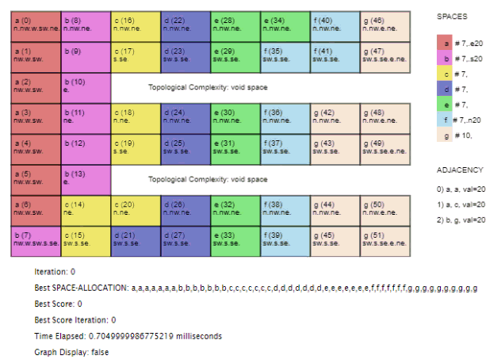
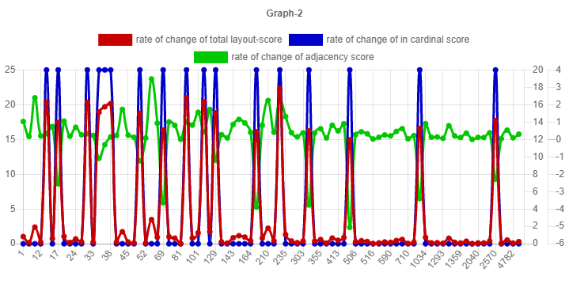
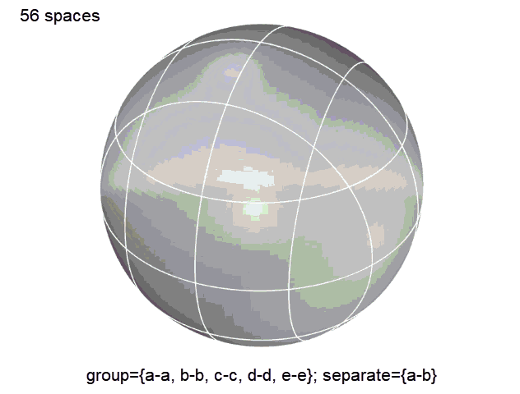
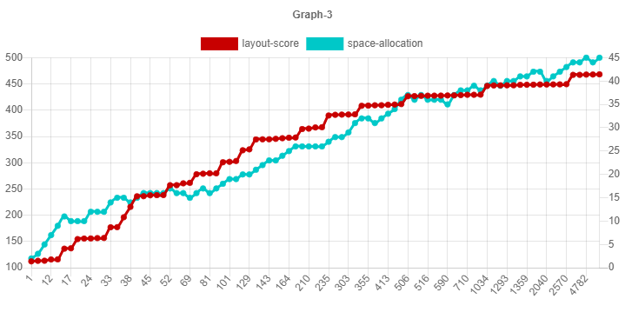
Problem Formulation
@ https://dots-ai.herokuapp.com/
Constraints in a nutshell
Adjacency
a-a,
a-c,
b-g
Orientation
a-> east
b-> south,
f-> north
Graph 1 :
layout-score
orientation-score
adjacency-score
Reinforcement Learning
Graph 2 : rate of change:
layout-score
orientation-score
adjacency-score
Graph 3 :
layout-score
change in layout

Slide 7
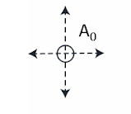
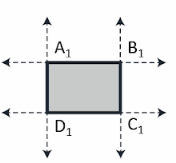
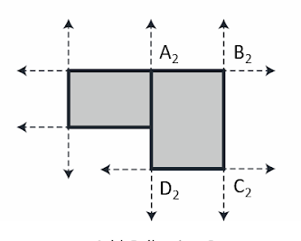
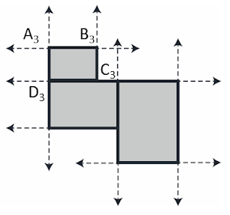

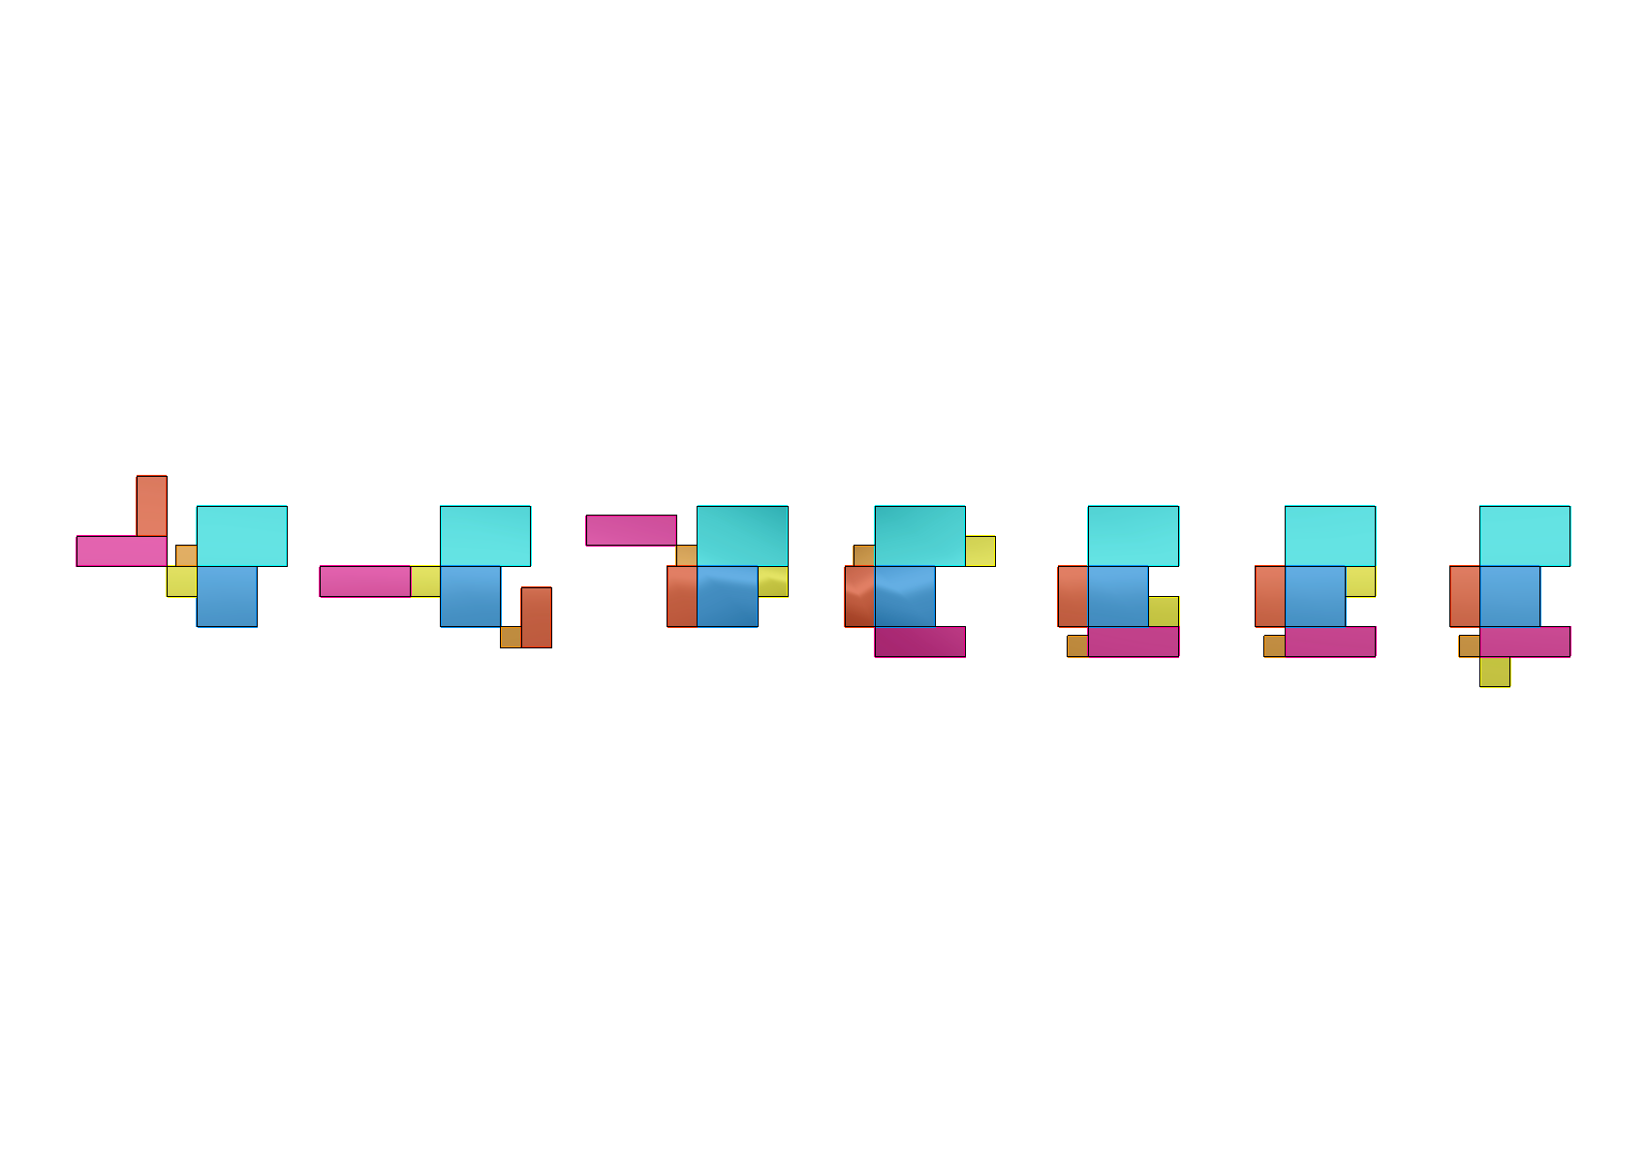
Formulation 1
Name | Length | Width | F1 | F3 | F5
F0 | 100 | 100 | 10
F1 | 70 | 70 |  | 10
F2 | 100 | 200 |  | 10
F3 | 300 | 100 |  |  | 10
F4 | 300 | 200 |  |  | 10
F5 | 200 | 200
Growing a configuration:
Constraints
f0
f1
McMC Iterations
f2
f3
f4
f5
f5
f0
f0
f0
f0
f0
f2
f0
f4
f0
Representation
f3
f5
f4
f4
f5
f3
f5
f5
f5
f4
f3
f1
f3
f2
f1
f4
f1
f2
f1
f2
f4
f2
f3
f1
f1
f2
f3
f3
f4
f5
f2
f1
Backtracking
f5
f0
f0
f5
f0
f0
f0
Missing Adjacency Relation
f3
f3
f5
f1
f1
Achieved
f1
f1
f1
f3
f1
f3
f1, f3, 8
f3, f5, 4
f0, f1, 7
f1, f3, 8
f3, f5, 4
f0, f1, 7
f3, f5, 4
f0, f1, 7
f1, f3, 8
f0, f1, 7
f0, f1, 7
No Error

Slide 8
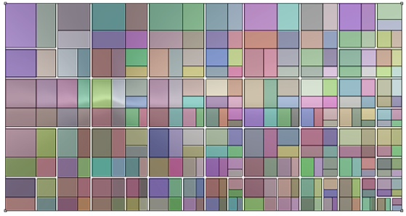
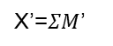
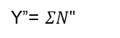
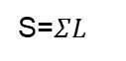

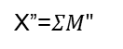
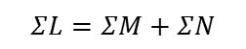
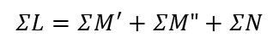
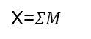
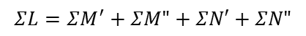
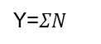
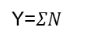
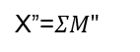
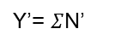
Formulation 2
Equivalence between requirements and the geometric operations
Generate Circulation
Binary Partition
Requirements - partitions
Geometric Equivalence
Area=$ΣL$
L={a,b,c,d}
S=$ΣL$
L={a,b,c,d}
$$ΣL=ΣM+ΣN$$
M={a,b}
N={c,d}
Y=$ΣN$
X=$ΣM$
S=$ΣL$
L={a,b,c,d}
M={a,b}
N={c,d}
X’=$ΣM$’
Y=$ΣN$
$$ΣL=ΣM^{′}+ΣM"+ΣN$$
M’={a}
M”={b}
X”=$ΣM"$
S=$ΣL$
L={a,b,c,d}
Y’= $Σ$N’
$$ΣL=ΣM^{′}+ΣM"+ΣN′+ΣN"$$
M={a,b}
N={c,d}
X’=$ΣM$’
M’={a}
M”={b}
N’={c}
N”={d}
X”=$ΣM"$
Y”= $ΣN"$
S=$ΣL$
very large layouts

Slide 9
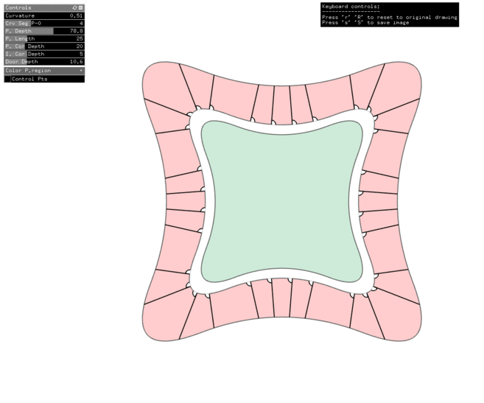
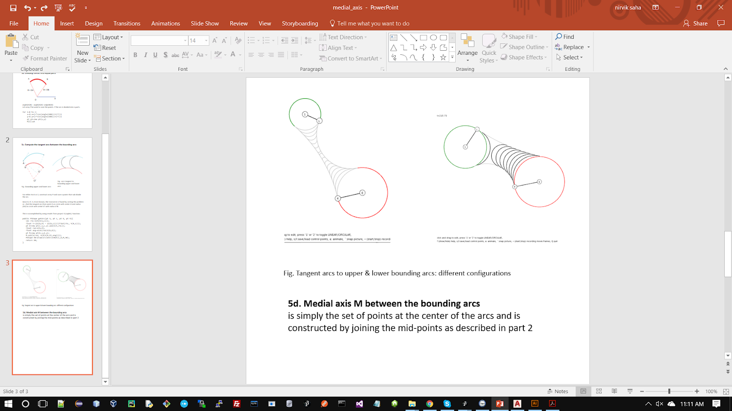
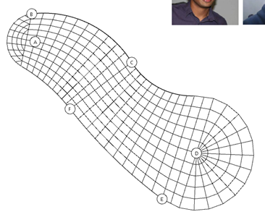
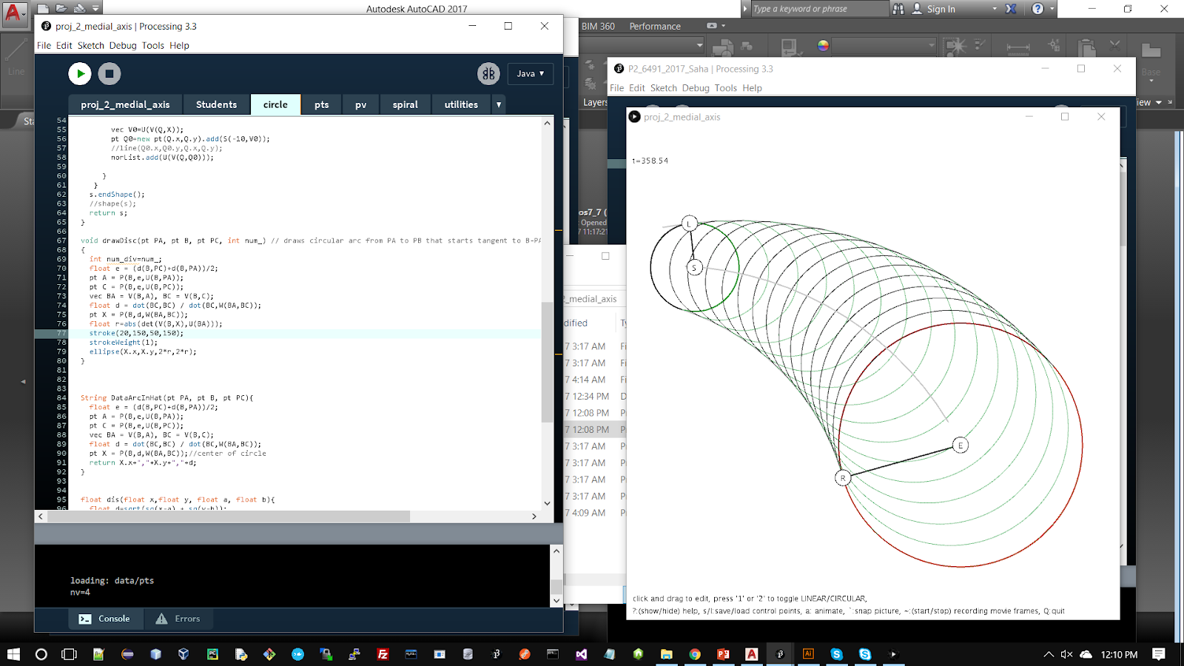
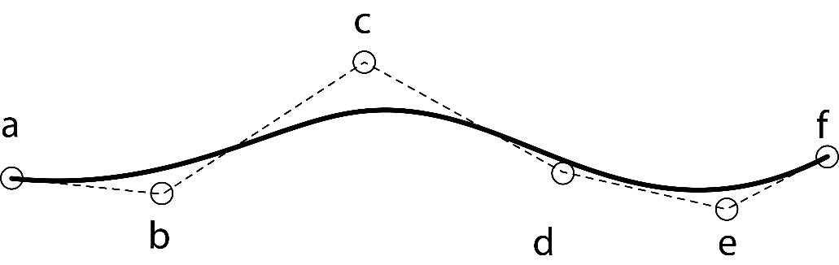
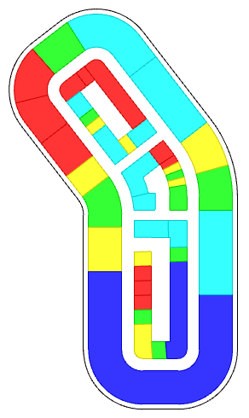
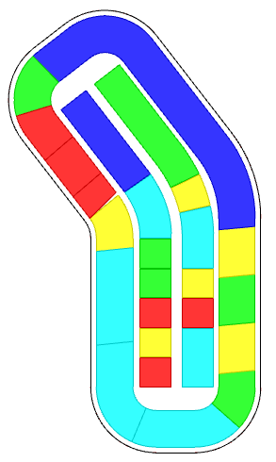
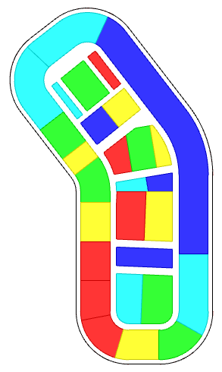
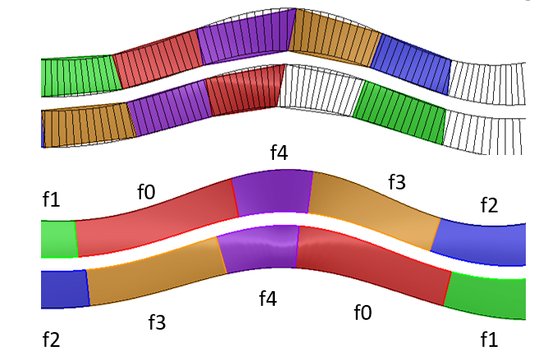
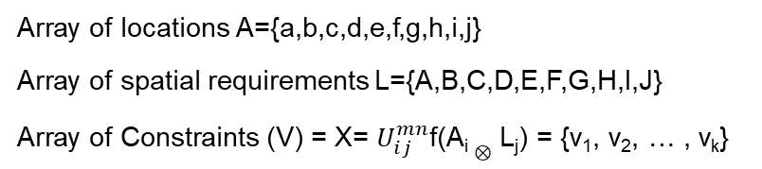
Formulation 3
Using Transformations & Discretization of region in a curve
Array of locations A={a,b,c,d,e,f,g,h,i,j}
Array of spatial requirements L={A,B,C,D,E,F,G,H,I,J}
Array of Constraints (V) = X= $U_{ⅈj}^{mn}$f(A_{i} $⊗$ L_{j}) = {v₁, v₂, … , v_{k}}
Seamless transformations:
Bernstein polynomial basis recurrence relation
f(t) = Σ_{i=0}^{n} (^{n}C_{i}) (1-t)^{n-i} t^{i}
spaces | Area | Depth | Number | rgb | f0 | f1 | f2 | f3 | f4
f0 | 1000 | 100 | 2 |  |  |  |  | 50
f1 | 300 | 100 | 2 |  |  | -50
f2 | 500 | 100 | 2 |  |  |  | -50
f3 | 850 | 100 | 2 |  |  |  |  | 50
f4 | 350 | 100 | 2 |  |  |  |  |  | 100
Discretization:
Medial Axis Transform
Combined Patterns
peripheral
longitudinal
transverse

Slide 10
Integrated data structures
Connected Methods
Design problems are nested
SAT
Optimize
SAT Generate
Models (M_{0-n})
Design problems
Geometric Forms
Organize relationships
Model-1
Model-2
SAP
workflow
workflow
Linked- multiple models
Notes:
In this thesis, a Space Allocation Problem is thought of as a set of tasks which can be mapped to computable models.
These models call a set of methods from a common pool of SAT.
By providing an integrated framework, the designer can combine models in various ways to generate unique solutions.
This paper presents a novel set of integrated space allocation techniques (SAT) to
generate architectural schemes of diverse functional and geometric typologies by distributing
spaces from a point, along a curve, or by partitioning a closed curve.
Simultaneously, reinforcement learning is used to optimize user-defined measurable attributes of the layout
such as outer boundaries, adjacencies, the distance between spaces, area, circulation, FAR distribution, and orientation

Slide 11
Explicit Design Process
Exploration
Semi-automation
Framework
Integrated Framework: novel SAP using permutations of process models
SAP (P_{i})
SAP (P_{i+1})
SAP (P_{i+1})
SAP (P_{n})
DESIGN PROBLEM
Design Optimization Tool Set (DOTS)
FRAMEWORK
model-1
model-2
model-n
USER ACCESS – process models
BLACK-BOX ALGORITHMS
SAT₁
SAT₂
SAT₃
SAT₄
SAT_{n-2}
SAT_{n-1}
SAT_{n}

Slide 12
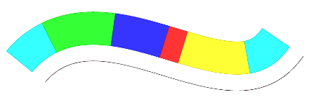

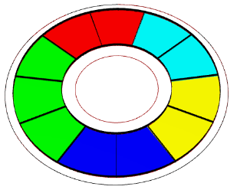










Framework
Symbol
Description
Illustration
Symbol
Description
Illustration
Plots rows of spaces based on geometry & adjacency given an open curve
Generates equal partition of spaces along the periphery of a given curve.
Creates the circulation for the partitioned region
Plots two rows of both geometry & adjacency for an open curve
Plots a 2D grid of spaces and organizes the activities
Plots geometry & adjacency for a given closed curve
Split a Curve into a core and quadrants
Partitions a given region into spaces and organizes the activities
Generates exact geometry of spaces by partitioning a given curve

Slide 13














Framework
Symbol
Description
Illustration
Symbol
Description
Illustration
Given a site, generates parcels along the periphery of the region
Basic Tower: Extrusion based on FSR, setbacks, etc
Sub-divides the region into parcels - for massing
Extrusion based on FSR, setbacks, step-backs, variable heights, etc.
Creates the circulation for the partitioned region
Generates courtyard typology based on fsr, setback. etc
Generates internal partitions and eliminates a region from the parcels
Selective extrusion of the podium
Given an internal polygon, generates parcels that correspond to the sides
Large-scale FSR allocation from streets for any given parcel geometry
Given a site and circulation, generates the parcels for massing or subsequent operations

Slide 14










Framework
Symbol
Description
Illustration
Symbol
Description
Illustration
Allocate footprints in a curve for Site Feasibility studies
Generate grid-circulation in a region
Allocate activities to floor plates vertically in buildings for Site Feasibility studies
Generate parcels to accept Fsr distribution
Organizes the activities to index of spaces for any given geometry of spaces - multiple sources (only optimization).
b,d,a,e,e,d,
c,a,b,c,b
Fsr distribution across Parcels from >1 points
Fsr distribution across parcels from curves and points

Slide 15








Framework
Result of operations
start
DOTS notation
end

Slide 16



Optimization Problem Formulation
Geometry Inputs
Name | Key | Area |  | Number
name_A | a | 500 |  | 2
name_B | b | 500 |  | 4
name_C | c | 1500 |  | 2
name_D | d | 750 |  | 4
name_E | e | 2000 |  | 5
Adjacency Inputs
Name | Key | a | b | c | d | e
name_A | a | 100 |  | 10
name_B | b |  | 10
name_C | c | 10
name_D | d |  |  |  | -50
name_E | e
Attract:
a-a
a-c
b-b
e-e
Repel:
d-d
Inputs
Initial Configuration
Optimization
Updated result

Slide 17






Semi-automation
1. Change constraints during the process
2. Change geometry
Name | Key | a | b | c | d | e
name_A | a | -100
name_B | b
name_C | c
name_D | d
name_E | e
Repel:
a-a
Generalize / flexibility
Name | Key | a | b | c | d | e
name_A | a | 100 |  | 10
name_B | b
name_C | c | 10
name_D | d
name_E | e
Attract:
a-a
a-c
3. Memory functions
Name | Key | a | b | c | d | e
name_A | a | 100 |  | 10
name_B | b |  | 10
name_C | c | 10
name_D | d
name_E | e
Attract:
a-a
a-c
b-b
Attract:
a-a
a-c
b-b
Repel:
a-a
Name | Key | a | b | c | d | e
name_A | a | 100 |  | 10
name_B | b |  | 10
name_C | c | 10
name_D | d |  |  |  | -50
name_E | e

Slide 18














Space Planning
Explicit Design Process
DOTS notation
Original Scheme without color-coding | Schema represented as zones of partial ordering | Zones:
 |  | A: Peripheral B: Corner Zones C: Central Zones D: Core
DOTS notation
<4 threads>
List of requirements: Neuro Patient Room, Patient Room, Ada Patient Room, Conference, Training Room, Neuro Monitor Room, Reading, Interview Room, Ptot Therapy, EVS, Consult, Seating Area, Family Lounge, Staff Lounge, Workstation, Meds, Clean Supplies, Staircase, Nour, EVS, Linen, Shared Office, Public Tlt, IS, Dir Office, Trash Recycle, Pts, Elec, Treatment Room, Respite Room, Food Gallery
<4 threads>

Slide 19




Additional Capabilities: Site Feasibility Study
DOTS notation
Building Details, proximity / distance matrix
Name & Identification |  | Geometric Constraints |  |  |  | Distance Constraints
Name | Key | Number | Footprint Area | Fsr | Ratio | a | b | c | Color
name_A | a | 2 | 100 | 0.5 | 0.75 | 12 | 12 | 5
name_B | b | 1 | 100 | 0.2 | 1.25 | 5
name_C | c | 3 | 100 | 0.2 | 0.75 | 5 |  | 12
name_D | d | 2 | 100 | 0.35 | 1.25 | 5
The distance matrix performs is similar to the adjacency matrix, unspecified values are assumed as 0
Activity Details
Identifier |  | Location Constraints |  | Building Identifier
Name | Key | Percentage | Height | Parent | Parent | Parent | Parent | Color
name_P | p | 20 | 50 | a | b | c | d
name_Q | q | 70 |  | a | c
name_R | r | 10 | 200 | a | b
Since the activity is allocated after placing the buildings, the parents are used to identify the building.

Slide 20










Interoperability for designers
Interoperability: Rhino - cloud (web app) - Dynamo
Cloud - mLab, Heroku (web)
https://dots-web.herokuapp.com/
Process Pipeline
Rhino3d, Grasshopper
Dynamo/Revit (BIM)
https://github.com/nirvik00/DOTS
https://github.com/nirvik00/DotsDynamoDll
User’s Software

Slide 21


Collaboration
Relationship
Constraints
Design Alternatives
Energy Plus Simulation (honeybee)
Energy
Solar harvesting Potential (ladybug)
Daylighting
Radiance (honeybee)
Evaluate Solutions
Openness
Sky view factor (ladybug)
Rezzae et. al., 2020;
Response | Predictor Variables
 | Number of Buildings | Number of thermal zones | Coverage Ratio | External wall area | Floor area ratio | Sky-view Factor | R² Value
Sky-view factor | ✓ | ✓ | ✓ | ✓ | ✓ | Х | 0.894
Potential solar power | ✓ | Х | Х | ✓ | Х | ✓ | 0.952
Energy Demands | Х | Х | Х | ✓ | Х | ✓ | 0.94
Energy Balance | ✓ | ✓ | Х | Х | Х | ✓ | 0.956
Chang et. al., 2019;

Slide 22

Conclusion

Slide 23
Future Work
Data-driven, “thoughtful”
design solutions
SAT
Sources of Information & Data
Recommendation Systems
process guidance
inference-based
Complimentary Platform
integrated logic
explicit design workflows
Semi-Automation
Performance Measurements
Spatial-temporal data
Origin-destination studies
Real time data
FOR a given scheme: energy analysis, daylighting,
of tourists, places of interest, visited,
from IoT devices and smart city platforms
GIS, mobile, tracking devices
local spikes in travels
amenity requirements

Slide 24
Technologies
Dots Plugin for Rhino/Grasshopper | https://github.com/nirvik00/DOTS
Dots-web (cloud service) | https://dots-web.herokuapp.com/
Dots Plugin for Dynamo BIM | https://github.com/nirvik00/DotsDynamoDll
Plugs-web solver | https://plugs-web.herokuapp.com/
Reinforcement learning illustrated | https://dots-ai.herokuapp.com/
Applications: Games using AI/ML | https://ai4dots.herokuapp.com/
Frameworks & Programming Languages used | C++, C#, Python, JS, Openframeworks, Processing, Three.JS, Rhino-common API, Dynamo API, NodeJS, MongoDB, Tensorflow, etc.

